Slide 1
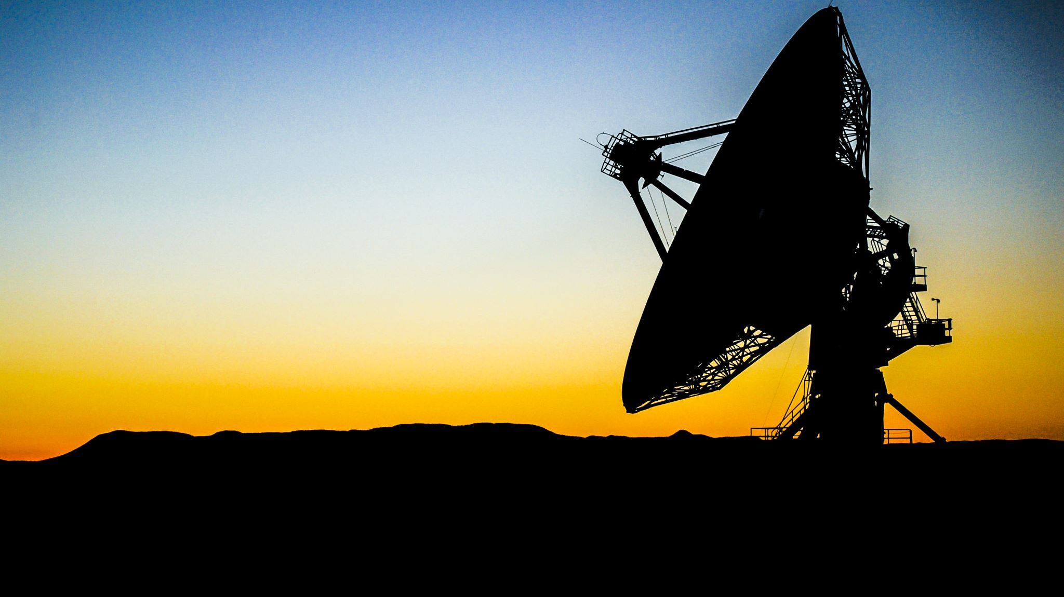
Antenna Pointer
10/01/24 Progress Presentation 1
Nathaniel Blair
By: Joshua Nutter
Cesar Vasquez
Notes:
Point to each one for intro

Slide 2
Senior Design 1: Team 3
Group Members (Th, 12-4pm)
Advisors (Wed, 2-4pm)
Nathaniel Blair, E.E., Current Team Leader
Joshua Nutter, M.E.
Cesar Vasquez, M.E.
Faculty
Main: Dr. Tej Lamichhane
Co: Dr. Evan Lemley
Co: Dr. Nesreen Alsbou
Industry: Jonathan Adams (FAA)
Notes:
Cesar:
Group meetings have been made on Tuesdays after class as well
Haven’t met with co
Tough meeting with industry
“FAA advisor out in Alaska, wilderness”

Slide 3
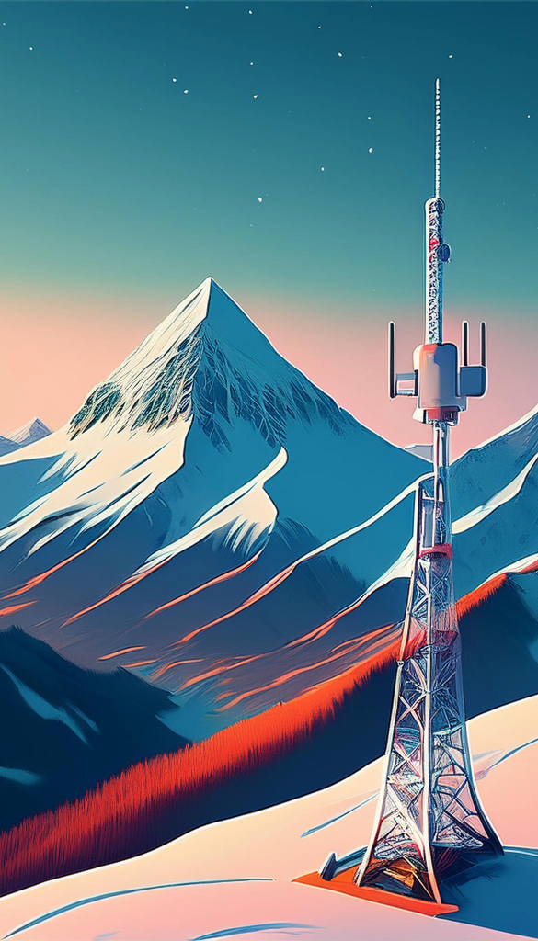
Introduction
Alaska Satellite Telecommunication Infrastructure team with FAA
No land lines due to infrastructure limitations
Setup antennas for remote stations
Pointed to geostationary satellites
Currently use compass and string for setup
Notes:
Why are we interested in it?
Josh:
Tie into issues with communication with industry advisor
“Carrying on with meetings, the issue we’ve had in communicating with our advisor is the solution this project solves”
“The FAA team in particular we’re working with is the Alaska Satellite Telecommunication Infrastructure”
Alaska frigid and barren
Lacks infrastructure, no wifi, landlines, outside communication other than antennas
bring into up to par with the rest of the world
Nathaniel:
Setup antenna…
Aging technologies
We found FAA using old parts interesting…
They currently use compass and string…

Slide 4

General Information
Azimuth and Elevation
Magnetic declination: Difference between True North and Magnetic North
World Magnetic Model: WMM gives magnetic declination based on position on Earth
Antenna offset
Notes:
Nathaniel:

Slide 5
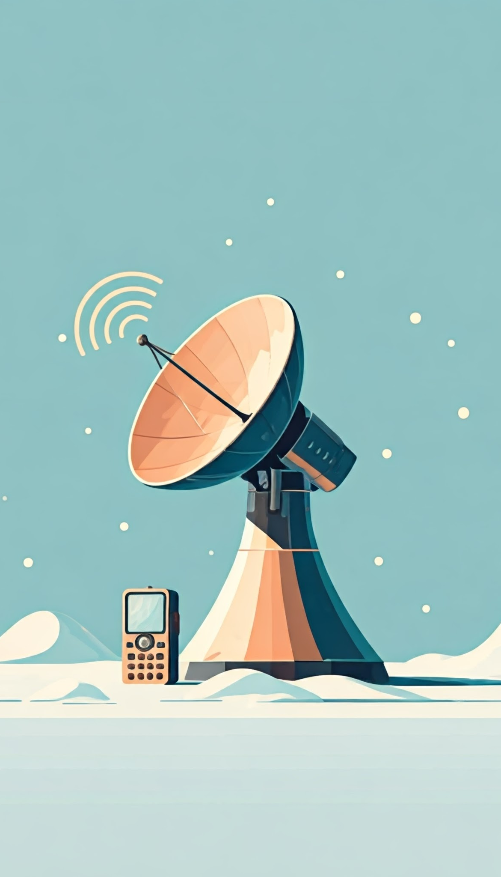
Deliverables
Digital handheld device
Outputs current antenna orientation
Battery powered
Withstands harsh weather
Usable in low light
Use with gloves
Notes:
Joshua:
Orientation, already have coordinates and elevation, find azimuth
Battery power is sufficient, which kind -- (insulation)
Materials to prevent device failure (structural/electrical)
Backlit device, Alaska is bright

Slide 6
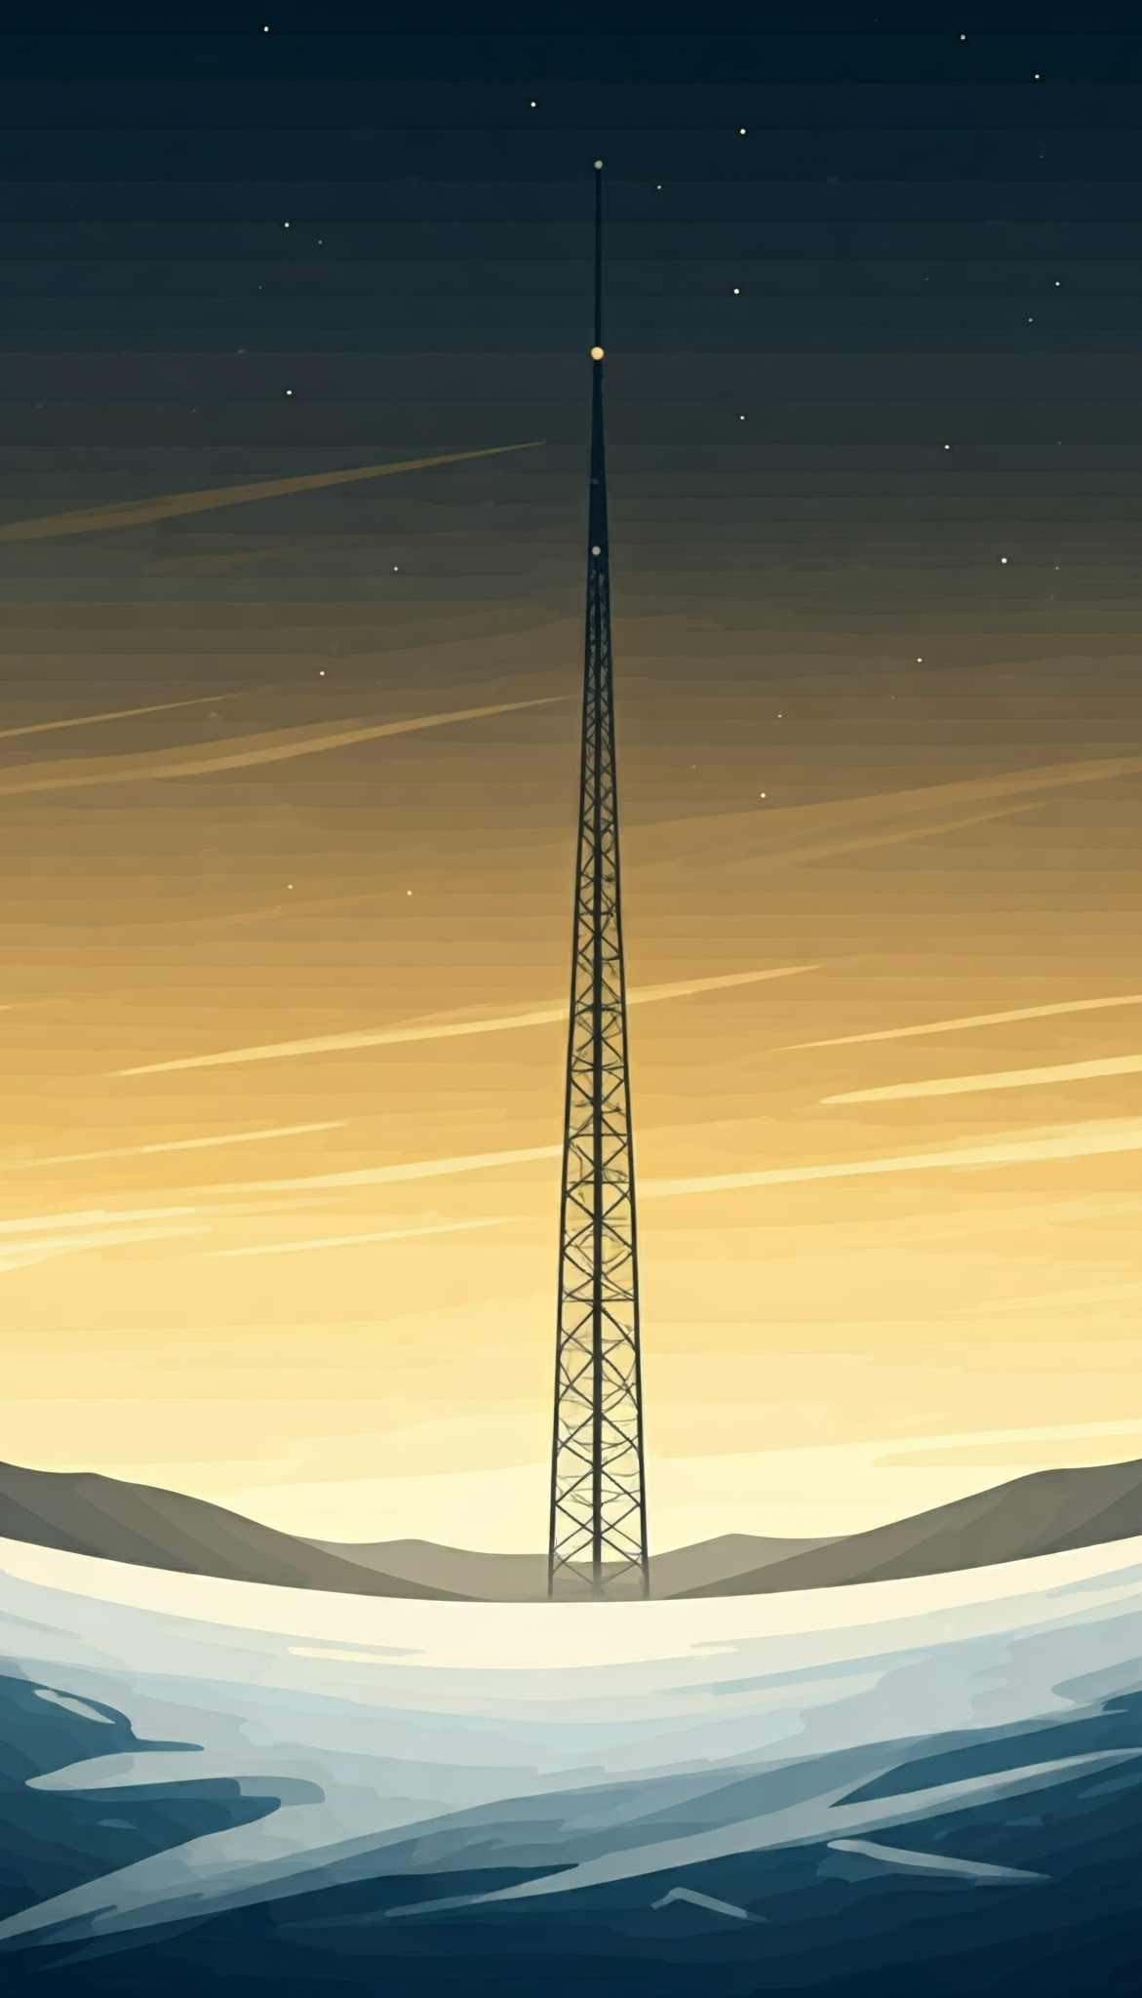
Plan of Execution
Raspberry PI
User Interface
GPS
User Location
Magnetic Declination
IMU for orientation
Digital compass
Gyroscope
Accelerometer
Ceramic coated fabric
Lightweight and durable
Non-magnetic
Insulated (Cold and heat proof)
Notes:
Nathaniel:
GPS used for magnetic declination, adjust azimuth
True north vs magnetic
Cesar:
Cannot be plastic as it will become brittle
No metal from advisor
Non magnetic
Heat gun

Slide 7
Scope of the Project
Mechanical
Electrical
All
Research calculations and products
Use SolidWorks for design
Code and wire device
Test materials
Python for calculations and user interface
Raspberry PI
Notes:
Nathaniel:

Slide 8
Timeline
Notes:
Cesar:
Met on Thursday 26th and got on the same page
Originally thought it would calculate coordinates or stationery on antenna
Advisor wanted to focus on solar or wind power

Slide 9

Questions?
Notes:
Joshua:

Slide 10

Thank you
Notes:
Joahua:

